Slide 1
Introduction to Statistics for Ecology and Evolutionary Biology Introduction to Multilevel Modeling Week 14 27 April 2020
Notes:
The goal for this lecture is to communicate the “what” and “how” of multilevel modeling
Next week is for more of the “why” question, but, broadly, multilevel strategies help our models learn more intelligently about the data at hand
Specifically when we have data organized into clusters of some sort: study sites, study individuals, etc.
“If you want improved estimates and predictions, use a multilevel model.”
“We should be justifying those times when we choose not use a multilevel model, not asking in every instance whether one would be useful.”
– Richard McElreath, http://elevanth.org/blog/2017/08/24/multilevel-regression-as-default/

Slide 2
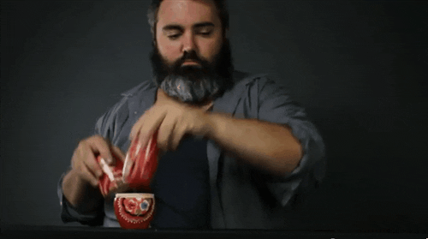
Models Embedded Within Models
Notes:
Our multilevel models are a bit like nesting dolls: in a sense, one model will have another model nested inside of it
https://media.giphy.com/media/Ud5r7tzmG4De0/giphy.gif

Slide 3
A Model of Many Names
Multilevel model will be the term most commonly used in this course
Hierarchical model is a (usually) synonymous term
As with multilevel model, the name hints at the fact that there are multiple levels of posterior inference
Mixed model is a (usually) synonymous term
When the outcome variable is something other than Gaussian, it is common to refer to a generalized linear mixed model (GLMM)
This name comes from the fact that these models are often said to contain fixed (i.e., main) effects as well as varying (i.e., random) effects
Notes:
The primary way to resolve these ambiguities is to define the model mathematically, which provides a more definitive description

Slide 4
Spiny-throated Reed Frog
Notes:
The experimental example in question concerns amphibian life history dynamics
https://www.iucnredlist.org/species/69119640/69119416

Slide 5
Notes:
Illustration of the various steps of reed frog life history
http://www.esapubs.org/archive/ecol/E086/086/appendix-A.htm

Slide 6
Notes:
Eggs of the reed frogs (and other species) are actually responsive to predator cues and can hatch earlier when under threat
This is called “predator-induced hatching plasticity”
http://www.esapubs.org/archive/ecol/E086/086/appendix-A.htm

Slide 7
Notes:
“Field sampling and experimental feeding trials suggest that libellulid dragonfly larvae are important aquatic predators of Hyperolius larvae in Amani Pond.”
So eggs that hatch early may be more vulnerable to predators in the tadpole stage
For the statistical modeling context, a primary issue is the fact that tanks are a crucial experimental unit
Tadpole density and other experimental treatments were manipulated at the tank-level and tank therefore represents a clustering variable
To illustrate multilevel models, we’ll be interested in modeling tadpole survival across tanks
Show lecture code introducing the reed frog data
http://www.esapubs.org/archive/ecol/E086/086/appendix-B.htm

Slide 8
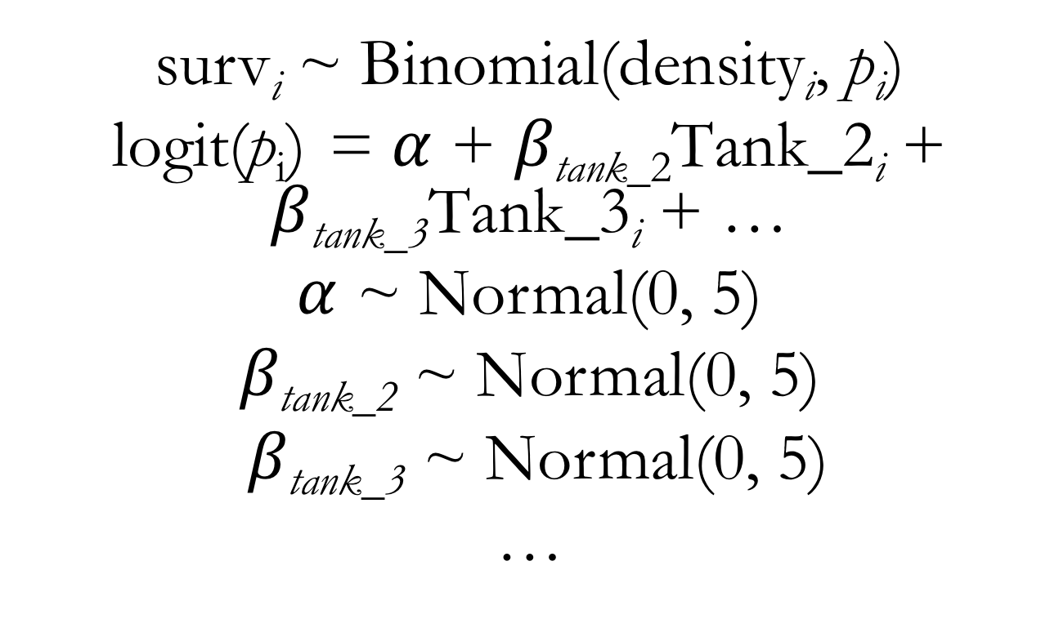
Binomial GLM for Reed Frog Survival Predictors: Tank (with the dummy variable approach)
surv_{i} ~ Binomial(density_{i}, $\text{p}\text{i}$)
logit(p_{i}) = $α$ + $β\text{tank}\text{_}\text{2}\text{Tank}\text{_2}\text{i}$ + $β\text{tank}\text{_3}\text{Tank}\text{_3}\text{i}$ + …
$α$ ~ Normal(0, 5)
$β\text{tank}\text{_2}$ ~ Normal(0, 5)
$β\text{tank}\text{_3}$ ~ Normal(0, 5)
…
Notes:
With the dummy variable coding approach, we fit an intercept term and every dummy variable’s coefficient represents one category’s difference (or offset) from the intercept value

Slide 9
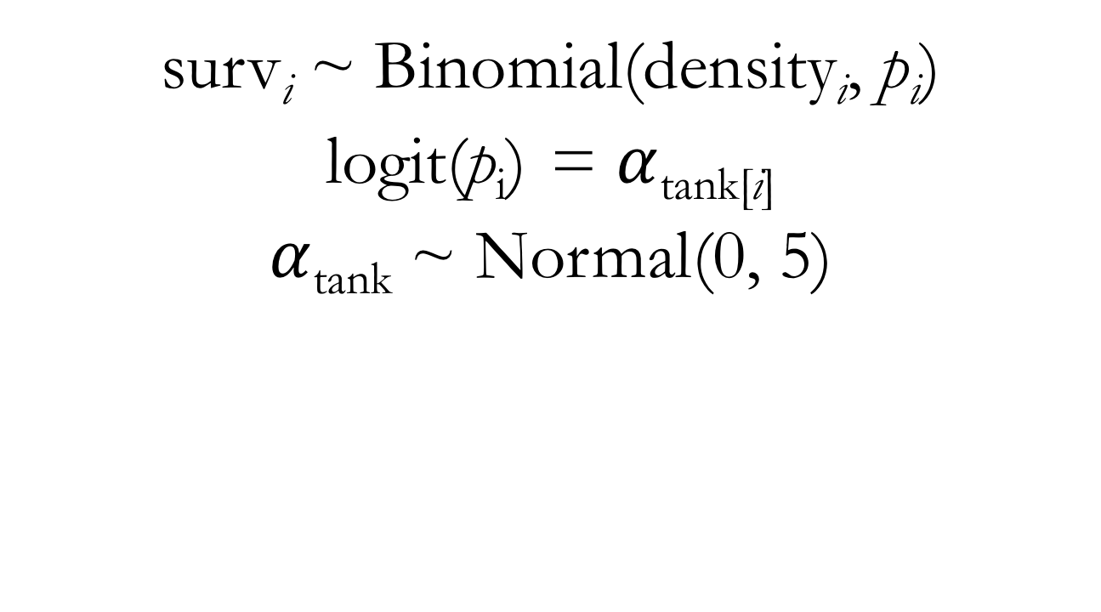
Binomial GLM for Reed Frog Survival Predictors: Tank (with an indexing approach)
surv_{i} ~ Binomial(density_{i}, $\text{p}\text{i}$)
logit(p_{i}) = $α$_{tank[i]}
$α$_{tank} ~ Normal(0, 5)
Notes:
With the indexing coding approach, we fit an intercept term that directly represents every category’s intercept value
Show lecture code for fitting a model using this strategy

Slide 10
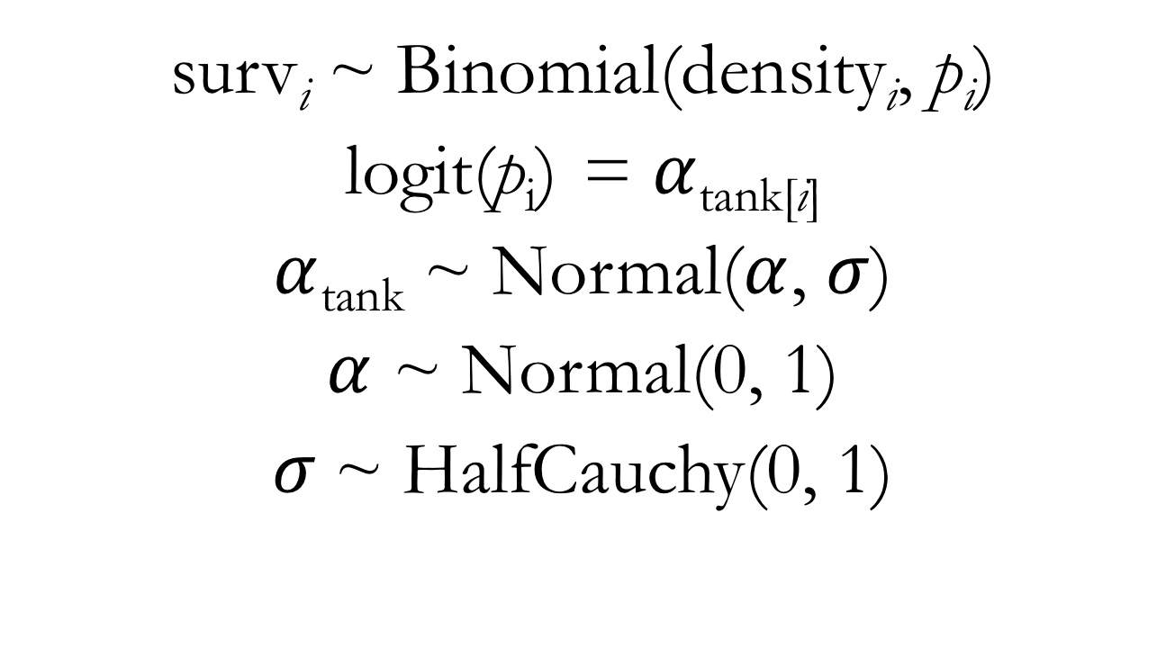
Binomial Multilevel Model for Reed Frog Survival Predictors: Tank (with an indexing approach)
surv_{i} ~ Binomial(density_{i}, $\text{p}\text{i}$)
logit(p_{i}) = $α$_{tank[i]}
$α$_{tank} ~ Normal($α$, $σ$)
$α$ ~ Normal(0, 1)
$σ$~ HalfCauchy(0, 1)
Notes:
This is what’s known as a varying intercepts model: we’ll get a unique intercept for each cluster in the data

Slide 11
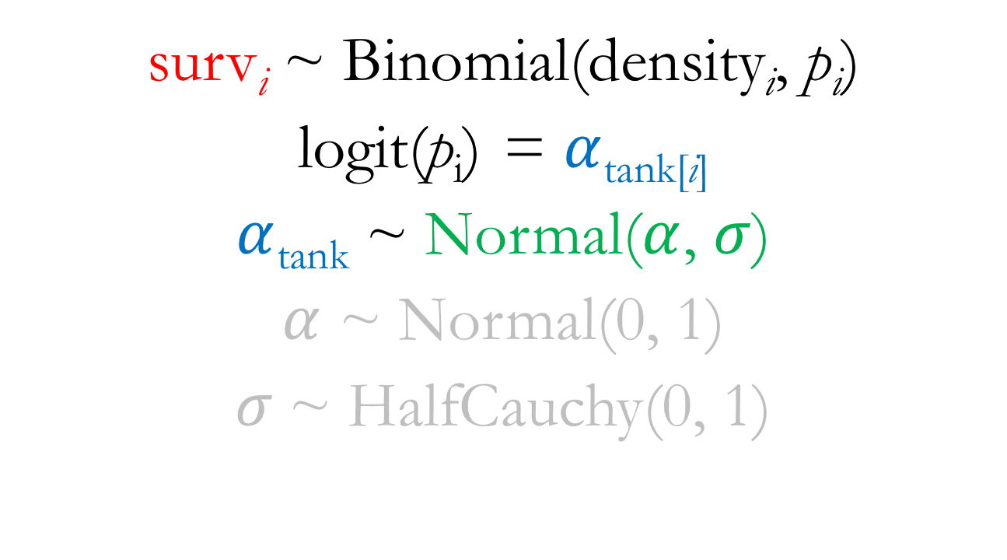
Binomial Multilevel Model for Reed Frog Survival Model Level One: Outcome, Parameters, Prior(s)
surv_{i} ~ Binomial(density_{i}, $\text{p}\text{i}$)
logit(p_{i}) = $α$_{tank[i]}
$α$_{tank} ~ Normal($α$, $σ$)
$α$ ~ Normal(0, 1)
$σ$~ HalfCauchy(0, 1)

Slide 12
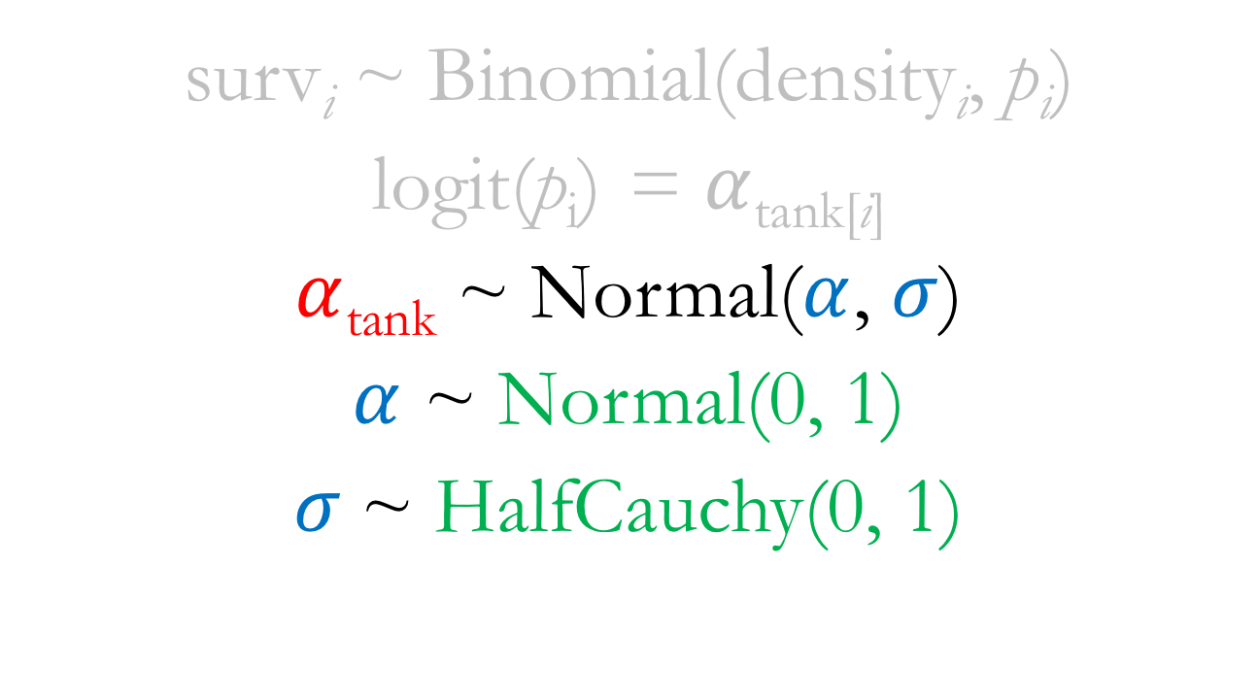
Binomial Multilevel Model for Reed Frog Survival Model Level Two: Outcome, Parameters, Prior(s)
surv_{i} ~ Binomial(density_{i}, $\text{p}\text{i}$)
logit(p_{i}) = $α$_{tank[i]}
$α$_{tank} ~ Normal($α$, $σ$)
$α$ ~ Normal(0, 1)
$σ$~ HalfCauchy(0, 1)
Notes:
Alpha and sigma are sometimes called hyperparameters
They are parameters for parameters
Their priors are called hyperpriors
This structure is what allows our model to adaptively learn about variation among clusters
We estimate each tank’s intercept using information from the other tanks

